Slide 1


Green Pace
Security Policy Presentation
Developer: Daniel Pham

Slide 2

OVERVIEW: DEFENSE IN DEPTH
Adopting a secure coding standard is a necessity to practicing Defense In Depth.
Secure coding practices should be executed at all times with top priority.
This will ensure that our code is secure by actively trying to prevent attacks but it makes anticipating and reacting to an attack much easier if it were to happen.

Slide 3
THREATS MATRIX
Priority: Coding standard with high risk assessment
Low Priority: Coding standard with low risk assessment
Unlikely: Threats that are not likely to occur
Likely: Threats that are more likely to occur
Likely STD-007 STD-005 | Priority STD-001 STD-010
Low priority STD-002 STD-003 STD-009 | Unlikely STD-004 STD-006 STD-008

Slide 4
10 PRINCIPLES
Validate Input Data
STD-001-CPP|STD-004-CPP|STD-007-CPP|STD-008-CPP|STD-009-CPP
Heed Compiler Warnings
STD-002-CPP|STD-003-CPP|STD-004-CPP|STD-005-CPP|STD-009-CPP|STD-010-CPP
Architect and Design for Security Policies
Keep it Simple
STD-001-CPP|STD-008-CPP
Default Deny
Adhere to the Principle of Least Privilege
Sanitize Data Sent to Other Systems
STD-006-CPP
Practice Defense in Depth
Use Effective Quality Assurance Techniques
STD-002-CPP|STD-003-CPP|STD-005-CPP|STD-007-CPP
Adopt a Secure Coding Standard
STD-006-CPP|STD-010-CPP

Slide 5
CODING STANDARDS
STD-001-CPP: DCL50-CPP - Do not define a C-style variadic function
STD-002-CPP: DCL37-C - Do not declare or define a reserved identifier
STD-003-CPP: DCL52-CPP - Never qualify a reference type with const or volatile
STD-004-CPP: DCL53-CPP - Do not write syntactically ambiguous declarations
STD-005-CPP: DCL54-CPP - Overload allocation and deallocation functions as a pair in the same scope
STD-006-CPP: DCL55-CPP - Avoid information leakage when passing a class object across a trust boundary
STD-007-CPP: ERR56-CPP - Guarantee exception safety
STD-008-CPP: OOP53-CPP - Write constructor member initializers in the canonical order
STD-009-CPP: ERR62-CPP - Detect errors when converting a string to a number
STD-010-CPP: FIO47-C - Use valid format strings

Slide 6
ENCRYPTION POLICIES
Encryption at Rest: Stored data that is encoded to prevent unauthorized users from being able to decrypt and access the data.
Encryption in Flight: The process of encrypting the data as it’s being transmitted.
Encryption in Use: The process of securing data in protected memory

Slide 7
TRIPLE-A POLICIES
Authentication: Authentication is the process of identifying a user by their username and password before network access is granted.
Authorization: Authorization is the process of enforcing policies granted to the user by allowing or denying their access to certain services and resources such as drives and folders.
Accounting: Accounting is the process of monitoring the resources that is consumed by an authorized user during their network access.

Slide 8
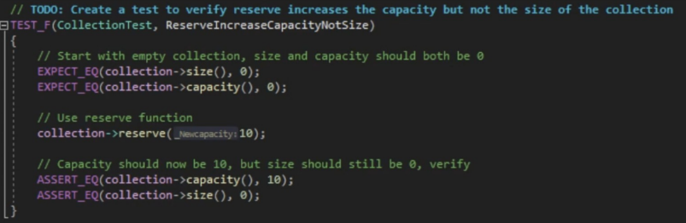
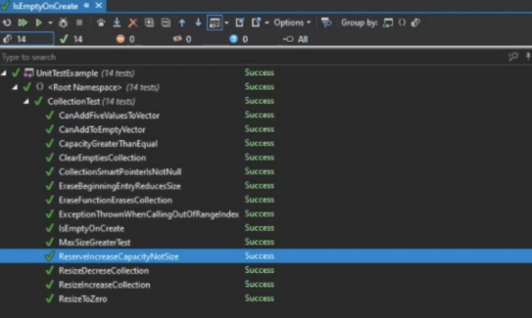
Unit Testing
Unit Testing allows for the testing of Memory Management which is one of an application’s most important components. The functionality of resizing and reserving data in memory is tested without saving it.

Slide 9


AUTOMATION SUMMARY

Slide 10
TOOLS
The DevSecOps pipeline encourages the integration of security practices such as threat analysis and policy enforcement into the already well-established DevOps process and infrastructure.
Automation should start in the Assess and plan stage in pre-production since that is generally where development starts. The security process should start as soon as possible and test as much as possible to detect any vulnerabilities.

Slide 11
RISKS AND BENEFITS
Problem: Green Pace’s current security policy requires an overhaul as it is currently not top priority.
Solution: Reinforcing and modifying the current DevOps infrastructure to automate the enforcement a variety of security practices and principles. The change of DevOps to DevSecOps.
Risk and Benefits of DevSecOps
Wait
Less resources required up front
Managing and tracing where in the SDLC failed the security breach
Overall cost may end up costing more than if the DevSecOps were incorporated initially.
Acting Now
Large requirement of resources to enforce security best practices in the initial stages of software development
Standardized security best practices leads to a more secure outcome in all stages of the SDLC
Anticipate, Prevent, React

Slide 12
RECOMMENDATIONS
Automation of DevSecOps starting from the Assess and Plan stage in pre-production
Manage and understanding the risks associated with employee access with the Triple-A Framework.
Default Deny security principle: by default, base access to applications is denied.
Base access must be focused on permission rather than exclusion

Slide 13
CONCLUSIONS
“Don’t leave security until the end”
Practice Defense in Depth
Adopt a Secure Coding Standard
Automation of enforcing the Secure Coding Standard

Slide 14
REFERENCES
Schiela, R. (2020, May 29). Sei cert C++ coding standard. SEI CERT C++ Coding Standard - SEI CERT C++ Coding Standard - Confluence. Retrieved December 11, 2022, from https://wiki.sei.cmu.edu/confluence/pages/viewpage.action?pageId=88046682
Thank you for your time!

